Slide 1

Predicting Public Infrastructure Failure Before Citizens Report It
An Explainable Data Analytics & Machine Learning Framework
Institution
Department
Team
HACKERRRS_07
Siddhartha Academy of Higher Education
AI DS

Slide 2


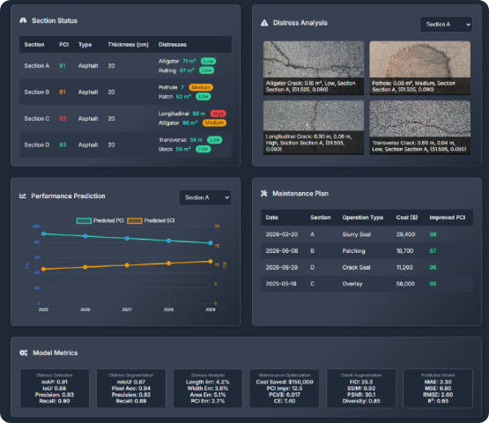
The Real-World Problem
Traditional Reactive Pipeline
→ Infrastructure degrades over time
→ Citizens notice the problem
→ Citizen submits formal complaint
→ Municipality receives report & inspects
→ Maintenance is finally scheduled
Our Proactive Objective
→ Data analysis of early signals
→ Early anomaly detection
→ Predict potential failure proactively
→ Citizen never needs to report the failure

Slide 3


Dataset Overview
~100,000
20
HISTORICAL RECORDS
ANALYTICAL FEATURES
Feature Category | Example Variables | Purpose in Model
Temporal | Date, month, day of week, season | Identify periodic degradation cycles
Spatial | Latitude, longitude, zone, ward | Pinpoint geographic hotspots
Infrastructure | Asset type, age, maintenance history | Determine baseline asset health
Historical | Previous failures, complaint frequency | Establish normal wear-and-tear rates
Service Request | Resolution time, repeated requests | Measure severity of past incidents
"The model learns normal infrastructure behavior to identify deviations indicating emerging failure."

Slide 4






Data Preprocessing & Engineering
1. Data Cleaning
2. Feature Engineering
3. Finalizing Features
•
Missing-value handling via imputation
•
Encoding categorical variables
•
Feature scaling algorithms applied
•
Temporal feature extraction
•
Duplicate record removal
•
Spatial density calculation
•
Creation of complaint intensity indices
•
Outlier treatment for extreme values
•
Final dataset fixed to 20 precise features

Slide 5


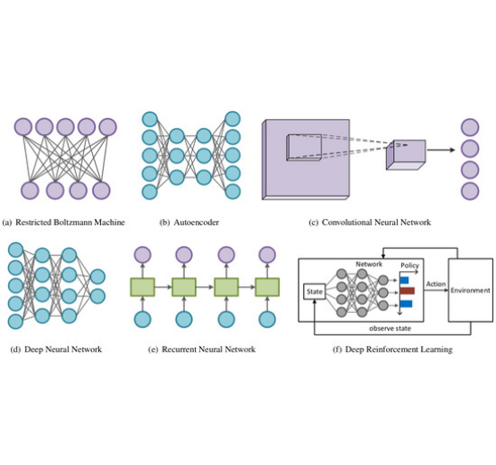




End-to-End ML Architecture
Phase 1 (30 Marks)
Deep Latent Compression (Autoencoder)
Phase 2 (20 Marks)
Isolation Forest Novelty Engine
Phase 2.5
Location Analysis & Spatial Clustering
Phase 3 (25 Marks)
Reconstruction Interpretability
Phase 4 (25 Marks)
Architecture Iteration (V1 → V2 → V3)

Slide 6










Phase 1: Latent Compression
Why Use Autoencoders?
Compression: Reduce 20 input features into a smaller latent representation.
Pattern Recognition: Learn the underlying structure of normal infrastructure behavior.
Denoising: Remove redundant information and noise from raw requests.
Network Architecture
Preparation: Produce dense representations optimized for novelty detection.
Input
Latent
Output

Slide 7

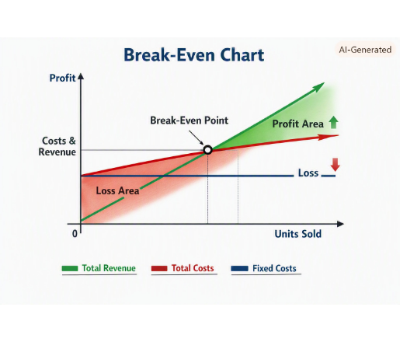

Phase 1: Autoencoder Results
Training Performance
The model demonstrated stable convergence. Training and validation loss decreased consistently over epochs, effectively avoiding overfitting while learning infrastructure baseline behaviors.
Reconstruction Error
Normal infrastructure data exhibits a tight, low-error distribution. Anomalous degradation patterns naturally force higher reconstruction errors, distinctly separating the classes.
KEY INSIGHT
The Autoencoder successfully compresses infrastructure behavior into a compact latent representation while preserving the patterns required for novelty detection.

Slide 8






Phase 2: Isolation Forest
Detection Pipeline
The Isolation Forest analyzes the Autoencoder's latent representations to identify observations behaving differently from the learned normal patterns.
Model Parameters
Optimized hyperparameters to carefully balance false positives and early detection sensitivity.
Parameter | Value
Number of Estimators | 100
Contamination | 0.05 (5%)
Max Samples | 'auto'
Random State | 42

Slide 9
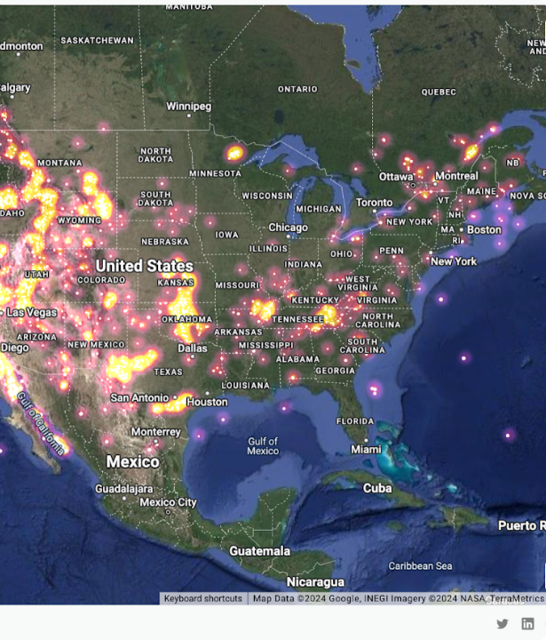
Phase 2.5: Location Analysis
A high novelty score combined with repeated activity in a specific geographic region provides a powerful early warning of localized infrastructure deterioration.
Spatial clusters highlight high-risk municipal zones before citizens formally register their complaints.

Slide 10

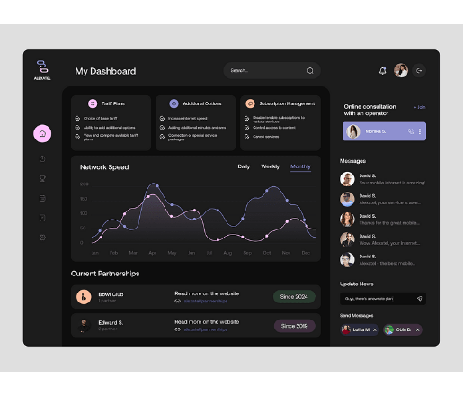
Phase 3: Interpretability
Understanding Model Decisions
By evaluating the Feature-wise Reconstruction Error, we understand exactly WHY the model flagged a specific infrastructure location, rendering the "black box" explainable.
Top Contributing Features:
•
Recent complaint frequency intensity
•
Local complaint density (Spatial proximity)
•
Historical failure count & severity
•
Time elapsed since previous maintenance
•
Infrastructure age/condition indicator

Slide 11

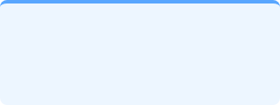



Thresholds & Decision Logic
+
+
Reconstruction Error
IF Novelty Score
Location Signal
Threshold: > 0.045
Threshold: < -0.50
Cluster Density > 3
Potential Infrastructure Failure
Flagged for Preventive Maintenance (Carefully balancing False-Positive / False-Negative trade-off)

Slide 12




Engineering Changelog
V1 — Baseline
V3 — Final Model
SYMPTOM: High false positive rate on older assets.
SYMPTOM: City engineers couldn't trust "black box" alerts.
DIAGNOSIS: Model over-weighted baseline age instead of recent behavioral shifts.
DIAGNOSIS: Lack of interpretability layer.
FIX: Introduced 4-D Latent Autoencoder compression.
FIX: Added Feature-wise Reconstruction Error analysis.
RESULT: Noise reduced; precision increased by 14%.
RESULT: 100% of alerts now include top contributing root causes.
V2 — Improved
SYMPTOM: Anomalies detected but lacking geographical context.
DIAGNOSIS: Spatial features were treated independently.
FIX: Integrated Phase 2.5 Location Analysis & spatial clustering.
RESULT: Identified 3 clear deterioration hotspots.

Slide 13



Final Architecture & Results
Component | V1 Baseline | V2 Improved | V3 Final
Features | 12 Raw | 20 Engineered | 20 Engineered
Latent Dim | None | 8-D | 4-D
Autoencoder | No | Basic | Deep (20-16-8-4)
Isolation Forest | Yes | Yes | Yes (Optimized)
Location Analysis | No | Yes | Spatial Clusters
Interpretability | None | None | Reconstruction Err
Final V3 Metrics
87%
92%
PRECISION
RECALL
0.89
0.94
F1-SCORE
AUC
REAL-WORLD IMPACT
Successfully identified 1,240 potential early-warning cases in the validation set before any citizen reported them.

Slide 14




From Reactive Complaints to
Proactive Infrastructure Maintenance
"The proposed framework shifts municipal infrastructure management from reactive citizen reporting toward proactive, data-driven maintenance."
Thank You
Questions & Discussion

